Slide 1
Heart Disease Risk Factors
By Gregorio Macias Garcia

Slide 2
Literature Review
In healthcare, risk factors are variables that increase the chances of having an illness or disease
Risk factors can include both preexisting health conditions as well as behaviors
Examples of preexisting health conditions that can increase the risk of heart disease are high blood pressure, high LDL cholesterol levels, diabetes and obesity (CDC)
Examples of behaviors that are risk factors for heart disease are an unhealthy diet, a lack of physical activity, tobacco use and alcohol abuse (WHO)

Slide 3
Literature Review
Machine learning methods are commonly used to improve disease prediction by medical researchers with methods such as Logistic Regression, Naïve Bayes, Random Forest, and k-Nearest Neighbors
In research done by Amzad Hossen, the performance of using Random Forest, Logistic Regression, and Decision Trees to predict heart disease was compared
A dataset with 303 occuraences and 14 variables was used
The results showed that logistic regression had the highest accuracy, with a score of 92%

Slide 4
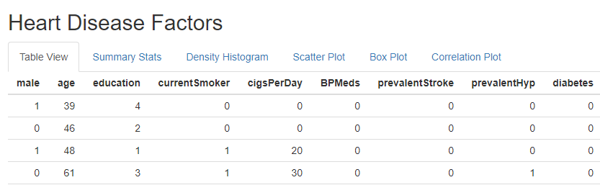
Design
The purpose of this study is to find heart disease risk factors
To accomplish this, patient data containing related variables, such as cholesterol and diabetes, will be analyzed to search for a link between these variables and heart disease
The analysis will include a Shiny app that includes various visuals to find insights to help guide future analysis, such as box plots and histograms

Slide 5
Data Collection
The dataset used for this project is from Kaggle.com
The data was originally obtained from a cardiovascular study taking place in Massachusetts
There are 4238 records and 16 variables
Number of Null Values for Fields with Missing Data:
cigsPerDay: 29
BPMeds: 53
totChol: 50
BMI: 19
heartrate: 1
Glucose: 388

Slide 6
Data Dictionary
+
Variable | Data Type | Definition
sex | Binary | Sex of the patient
age | Number | Patient age
education | Number | Number of education years
currentSmoker | Binary | Smoker Yes or No
cigsPerDay | Number | Number of cigarettes per day
BPMeds | Binary | Taking Blood Pressure Meds Yes or No
prevalentStroke | Binary | Have Strokes Yes or No
prevalentHyp | Binary | Have Hypertension Yes or No
diabetes | Binary | Have Diabetes Yes or No
totChol | Number | Total cholesterol levels
sysBP | Number | Systolic Blood Pressure
diaBP | Number | Diastolic Blood Pressure
BMI | Number | Patient Body Mass Index
heartRate | Number | Patient heart rate
glucose | Number | Patient glucose level
TenYearCHD | Binary | Patient has heart disease Yes or No

Slide 7
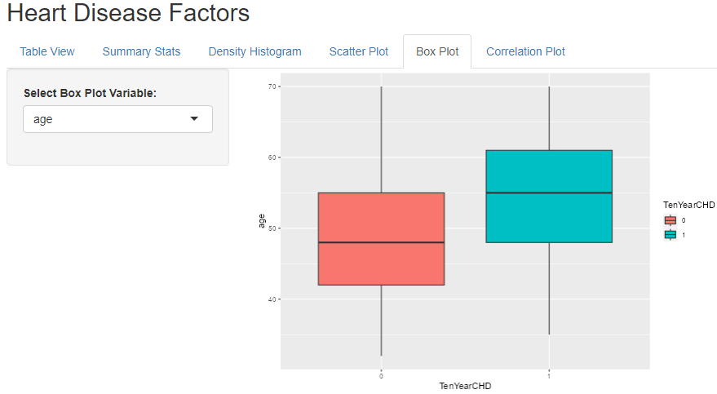
Possible Heart Disease Factors
Box plots were used to identify potential heart disease factors by comparing the medians between patients with and without heart disease. Below are the findings:
People with heart disease have a higher median age
People with heart disease have a higher median systolic blood pressure
People with heart disease have a higher median diastolic blood pressure
People with heart disease have a higher median cigarettes per day
People with heart disease have a higher median total cholesterol
People with heart disease have a higher median BMI
Unlikely Factors:
Patients with and without heart disease have very similar mean glucose and heart rates, so it is likely these are not risk factors

Slide 8
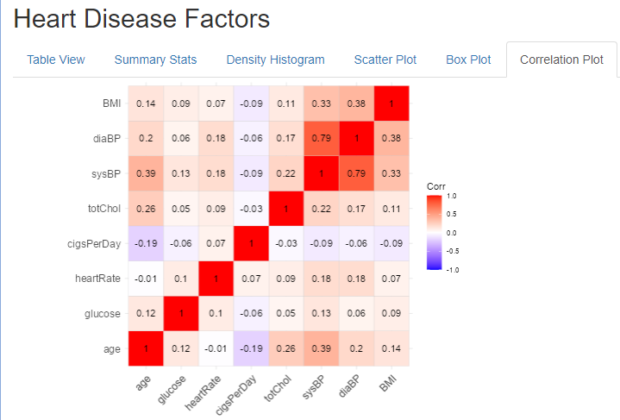
Multicollinearity
When conducting regression, one of the assumptions to look for is multicollinearity
To find multicollinearity a correlation plot was used to find correlations between potential independent variables
The only variables will potential auto-correlation are systolic and diastolic blood pressure. Depending on model assessment results, it would likely beneficial to only use one of these variables in the final model

Slide 9
Future Analysis
The various insights found with the exploratory data visuals can be used to train a logistic regression model to predict heart disease in patients
The model could use the variable TenYearCHD, which is a binary variable that classifies pateints as either having heart disease or not having heart disease
The independent variables could be the variables that are likely to be related with heart disease based on the median comparisons, such as age
It is likely that the final model shouldn’t include glucose or heart rates since the medians are very similar in both types of patients, but models should be compared with and without these variables
It is likely that only one of systolic or diastolic blood pressure should be included in the final model given that they are highly correlated

Slide 10
Sources
Logistic regression To predict heart disease | Kaggle
Supervised Machine Learning-Based Cardiovascular Disease Analysis and Prediction (hindawi.com)
NCHS Data Brief, Number 103, August 2012 (cdc.gov)
Cardiovascular diseases (CVDs) (who.int)
Effectively Predicting the Presence of Coronary Heart Disease Using Machine Learning Classifiers - PMC (nih.gov)

Slide 11
GitHub Link
https://github.com/gregorio1gmg/HeartDiseaseFactors

